Slide 1
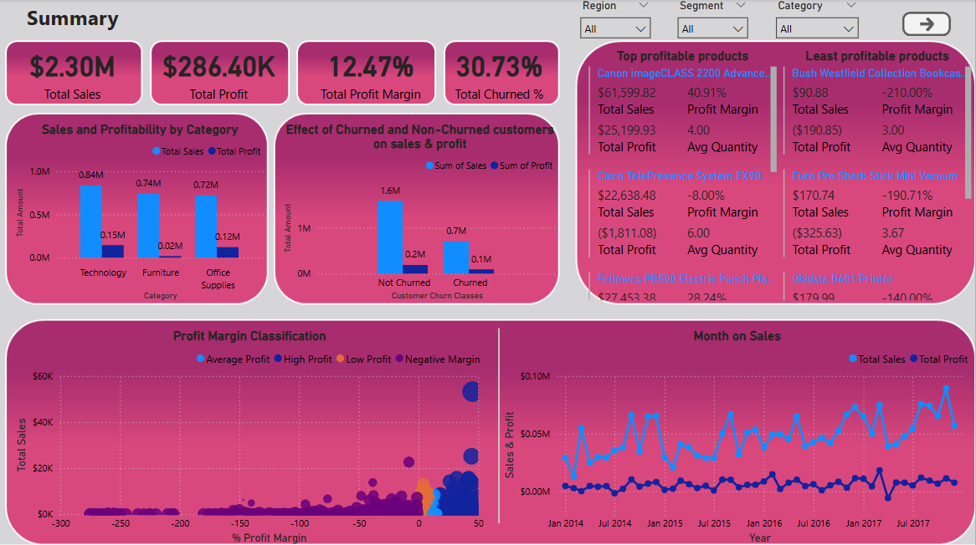
Retail Sales & Profit Optimization Dashboard – Superstore Case Study

Slide 2
Summary
This dashboard helps uncover profit improvement opportunities by analyzing product performance, customer behavior, and regional trends. The goal was to identify products and customer segments that are high in potential but underperforming in profitability — enabling smarter discounting, focused marketing, and inventory planning.
Key Findings:
Profit margin erosion is evident in heavily discounted furniture products.
Technology, while lower in volume, brings the highest profit contribution.
The West region is the strongest performer; the South underperforms due to higher discounting.
Churned customers contribute ~30% less profit on average than loyal ones.

Slide 3
Business Objective
To increase overall sales and profitability by identifying and optimizing low- performing segments, categories, and regions with high profit margins but low sales, while minimizing focus on areas with both low sales and low profitability.

Slide 4

Summary Cards (KPIs)
The overall profit margin is modest, and nearly one-third of customers have churned, signaling a need to improve both customer retention and profitability strategy.
Focus on reducing churn while increasing high-margin product sales. A churn rate above 30% is high and requires targeted customer retention efforts.

Slide 5
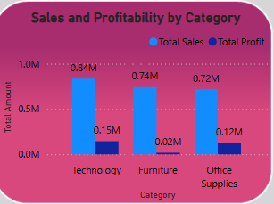
Sales and Profitability by Category
This visual compares total sales and total profit across three product categories: Technology, Furniture, and Office Supplies.
While Technology leads both in sales ($0.84M) and profit ($0.15M), Furniture shows a major imbalance—contributing $0.74M in sales but only $0.02M in profit. Office Supplies, despite lower sales, returns a decent $0.12M profit. This indicates poor profitability in the Furniture category.
The Furniture segment needs further analysis into pricing, discount strategy, and cost structures. Meanwhile, Technology and Office Supplies show higher margin potential for further investment and optimization.

Slide 6
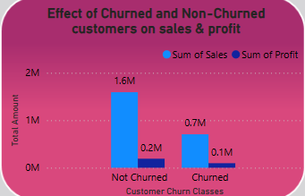
Effect of Churned vs. Non-Churned Customers on Sales & Profit
This chart compares sales and profit between churned and non-churned customer groups.
Non-churned customers drive the majority of revenue ($1.6M) and profit ($0.2M), while churned customers contribute significantly less ($0.7M in sales and $0.1M in profit). This indicates that retained customers are more profitable and higher spending.
Focus on improving retention strategies through loyalty programs or personalized offers, especially targeting customers at risk of churn to protect future revenue and profitability.

Slide 7
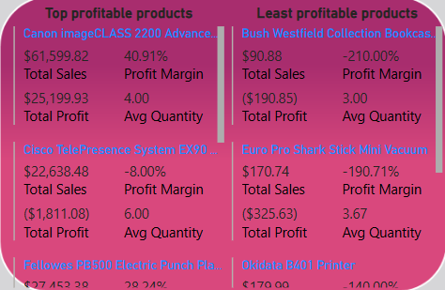
Top and Least Profitable Products
These multi-row cards list the highest and lowest profit margin products sold with average quantities above 3.
op-performing products like the Canon imageCLASS and Fellowes Punch generate high profit margins (above 28%), while products such as Bush Bookcases and Euro Pro Vacuums have extremely negative margins, despite selling more than three units. This reveals product-level inefficiencies.
Discontinue or reprice loss-making products after investigating their costs. Boost marketing and stock of high-margin products that show potential for scale and stable returns.

Slide 8
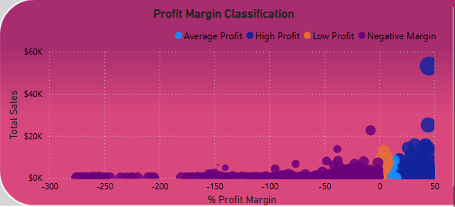
Profit Margin Classification
Each point represents a product, plotted by profit margin vs. total sales, and color-coded by margin category (high, low, average, negative).
High-profit items tend to cluster in the right-top quadrant, showing both strong margins and sales volumes. A large group of products falls into low-margin or negative-margin zones, dragging down overall profitability.
Review and optimize the product mix to reduce reliance on low-margin items. Focus on scaling high-margin products that are already performing well.

Slide 9
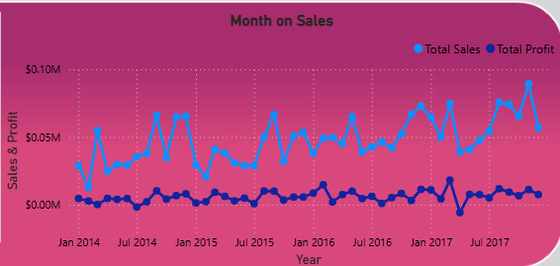
Monthly Trend of Sales and Profit
This line chart tracks total sales and profit month over month from 2014 to 2017.
While sales show a gradual upward trend with seasonal peaks, profit remains mostly flat with minimal growth, indicating operational or pricing inefficiencies that limit profit gains.
Investigate high-sales months with low profit to identify causes like discounting or cost spikes. Consider aligning promotional strategies to increase margin effectiveness during peak periods.

